Slide 1
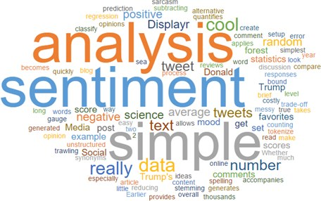
Sentiment Analysis

Slide 2
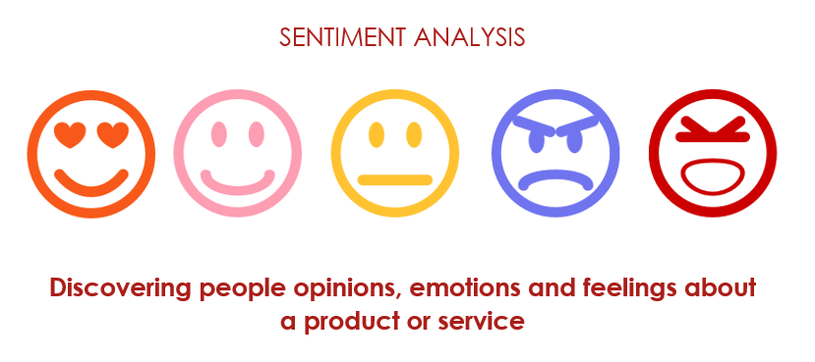

Slide 3
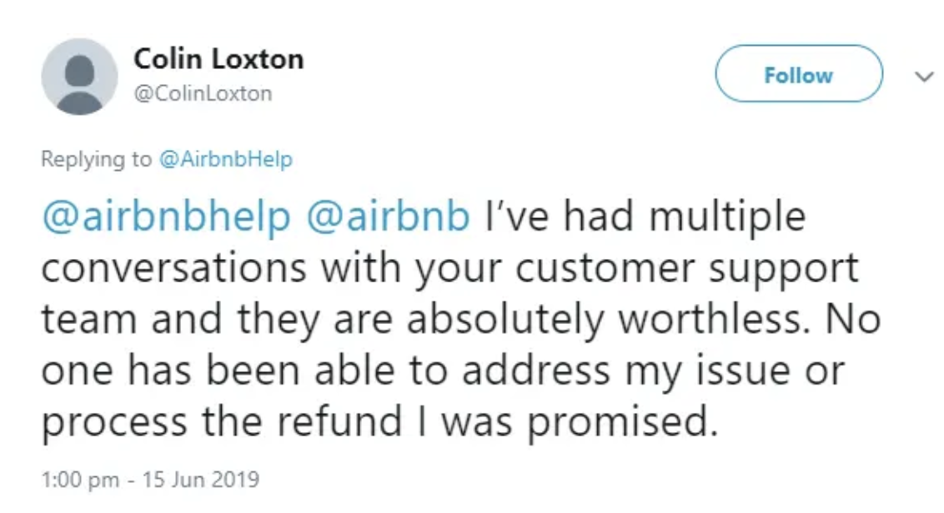
Sentiment Analysis

Slide 4
Definition
Sentiment analysis is contextual mining of text which identifies and extracts subjective information in source material.

Slide 5
Why sentiment analysis is important?
It’s estimated that 80% of the world’s data is unstructured: e.g. text data, image, video.
Emails, WeChat, social media, surveys, articles, and documents.
WeChat.

Slide 6
Why sentiment analysis is important?
Scalability
Real-time analysis
Consistent criteria

Slide 7
Sentiment Analysis: Application
New product release:
Collect insights on people’s attitudes, experiences, and needs.
Use sentiment analysis to track different sources of online conversations: Twitter, Facebook, etc.

Slide 8
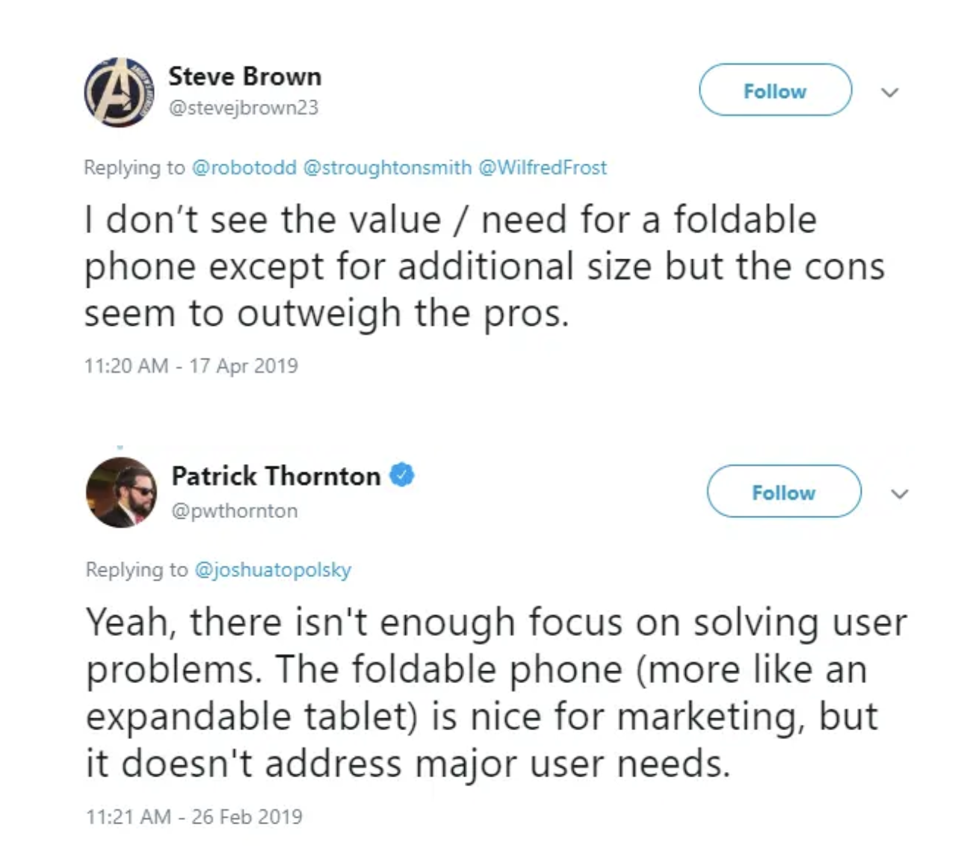
Sentiment Analysis: Foldable Phone

Slide 9
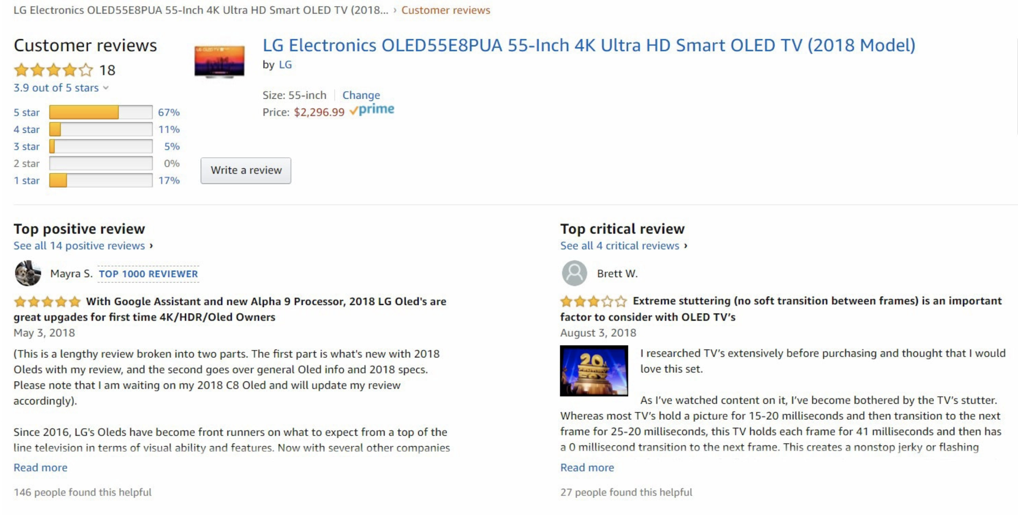
Sentiment Analysis: Customer Service

Slide 10

Sentiment Analysis: Donald Trump

Slide 11
Package: Sentimentr
‘Sentimentr’ allows you to quickly do a sophisticated sentiment analysis and directly use it as an input for your regression or any other further analysis.

Slide 12
Polarity Analysis
Polarity Analysis:
Very positive: Fantastic (+5)
Positive: Good (+2)
Neutral: OK (0)
Negative: Bad (-2)
Very negative: Terrible (-5)

Slide 13
Polarity Analysis
Valence Shifters
A negator flips the sign of a polarized word (e.g., "I do not like it.").
An amplifier (intensifier) increases the impact of a polarized word (e.g., "I really like it.").
A de-amplifier (downtoner) reduces the impact of a polarized word (e.g., "I hardly like it.").
An adversative conjunction overrules the previous clause containing a polarized word (e.g., "I like it but it's not worth it.").

Slide 14
Emotion Analysis
Emotion analysis aims at detecting emotions like, happiness, frustration, anger, sadness, and the like.
16 different emotions.
Implementation in R.

